Slide 1
Linear Equations in Linear Algebra
1.6 Linear Independence
Bumhee Cho

Slide 2
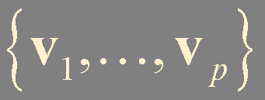
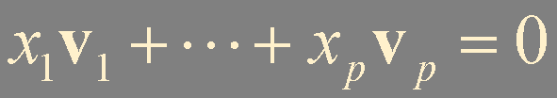
Linearly Independent
A set of vectors
in ℝ^{n}
is said to be linearly independent
if the vector equation
has only the trivial solution

Slide 3
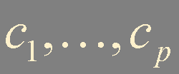
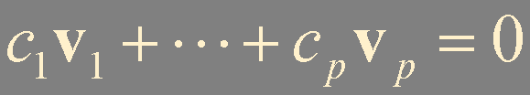
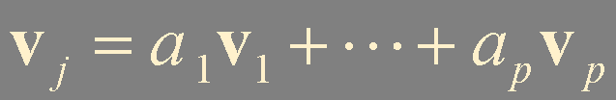
Linearly Dependent
The set
in ℝ^{n}
is said to be linearly dependent
if there exist weights
, not all zero,
such that
Notes:
coefficient가 하나만 nonzero여도 된다.
그럼 특정 vector가 다른 vector들의 “항상” “linear combination으로 표현될수있는가?”
아니다. 예를들어 vj의 coefficient가 0이였다고하면 0으로 다른 coefficient를 나눌수 없기에 항상 이렇게 표현될수는 없다.
물론 표현되는 경우도 있지만, 요점은 어떤 set이 linearly dependent 하다고해서 set안에 있는 임의의 vector가 다른 vector들의 linear combination의 조합이라는 보장은 없다.

Slide 4
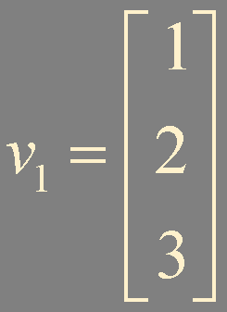
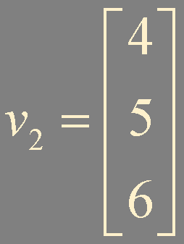
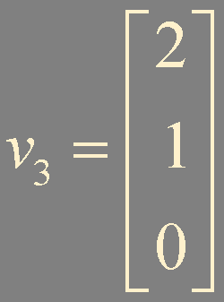
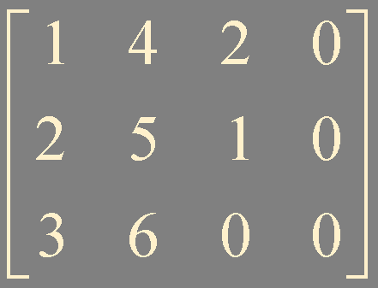
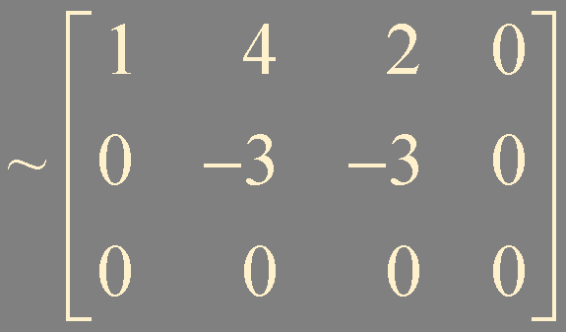
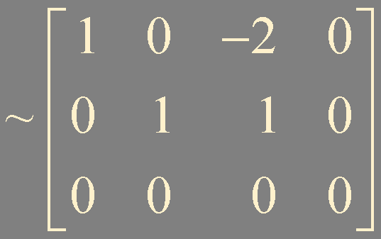
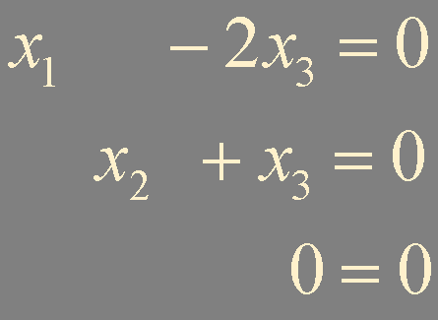

Example 1.
linearly dependent !
Notes:
free variable이 있기에 이미 nontrivial solution이 있다는것을 알고, 이는 정의에 의해서 linearyly dependent 하다는걸 의미.

Slide 5
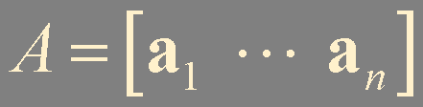



Linear Independence of Matrix Columns
The columns of a matrix
are linearly independent
if and only if the equations
has only the trivial solution.

Slide 6
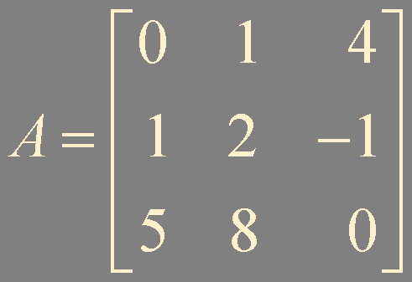
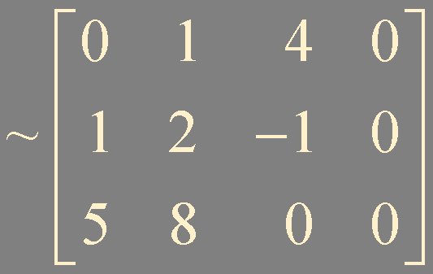
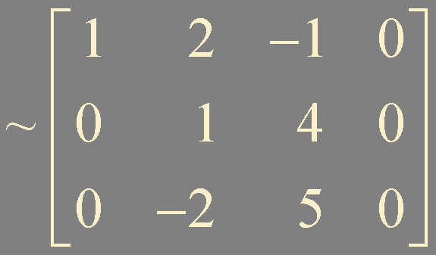
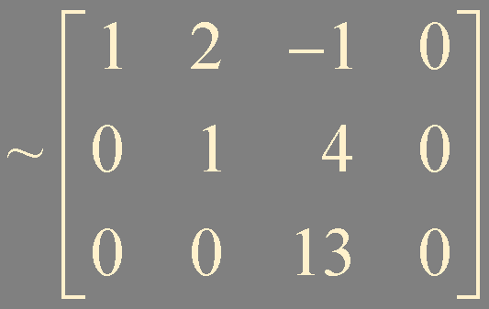
Example 2. Determine if the columns of the following matrix are linearly independent
only trivial solution
linearly independent

Slide 7



Sets of One Vector
If a set contains only one vector,
, then the set is linearly independent
only when
Notes:
어떤 vector set에 vector가 하나 혹은 두개만 있으면 dependent를 쉽게 판별할수있다.

Slide 8





Sets of Two Vectors
A set
is linearly dependent
if at least one of the vectors is a multiple of the other
The set is linearly independent, if and only if
neither of the vectors is a multiple of the other
Notes:
서로의 multiple이 아닌 상황에서 마지막식이 linearly dependent 할 수 있을까?
dependent 하다면 v1(혹은) v2의 coefficient가 nonzero라는 뜻이고 이런 형태로 표현이 되는데, 이건 모순이므로 무조건 linearly independent 해야함

Slide 9
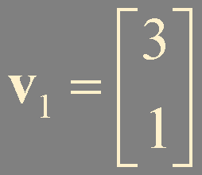
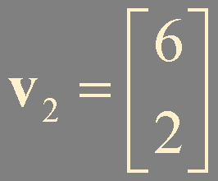
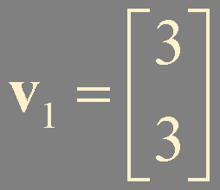



Example 2.
a multiple of the other
neither
linearly dependent
linearly independent
Notes:
두번째 예제: 한쪽이 0 vector였다면 dependent 였을텐데요.

Slide 10
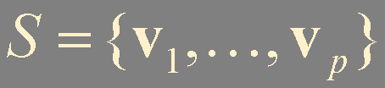

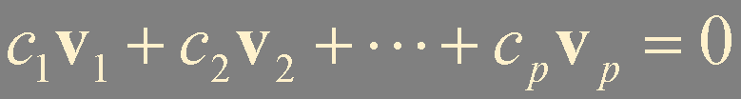
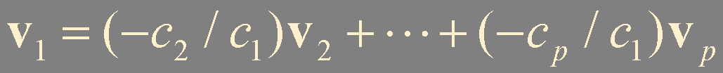
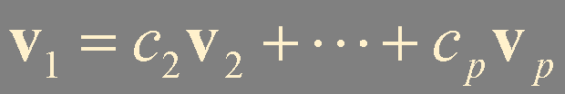
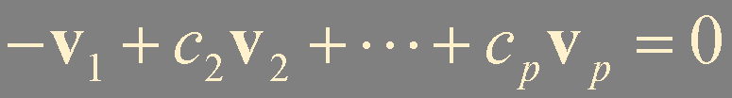
Theorem 7. Characterization of Linearly Dependent Sets
An indexed set of two or more vectors is linearly dependent
if and only if at least one of the vectors in is a linear combination of the others.

Slide 11



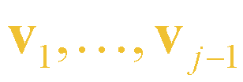


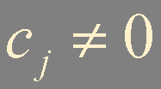



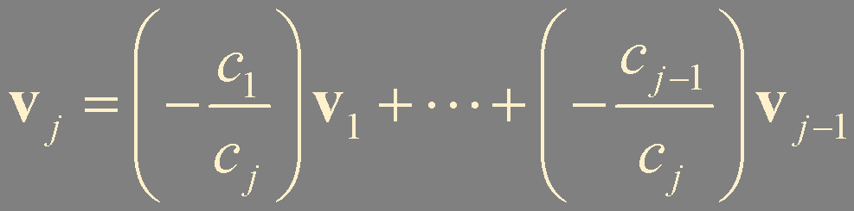
Theorem 7. Characterization of Linearly Dependent Sets
In fact, if is linearly dependent and ,
then some (with ) is a linear combination of the preceding vectors,
: the largest subscript for which

Slide 12








in ℝ³
with and linearly independent
is in
if and only if the set is linearly dependent.
Notes:
이론 7번에 의해 {u,v,w} 중 어떤 vector는 앞선 다른 백터의 linear combination이여야하는데, u가 nonzero vector이고, 서로 independent하기때문에 그 어떤 벡터는 w여야만함. 즉, w 는 Span{u,v}에 존재

Slide 13





Theorem 8.
If a set contains more vectors than there are entries in each vector,
then the set is linearly dependent
must be a free variable !
has a nontrivial solution
Notes:
n행 모두에 pivot 포지션이 있어도, p>n이기때문에 항상 한개 이상의 free variable이 존재함. 이 말은 Ax=0가 nontrivial solution을 가지고 있다는 뜻.

Slide 14
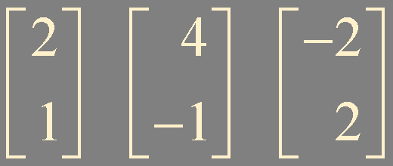
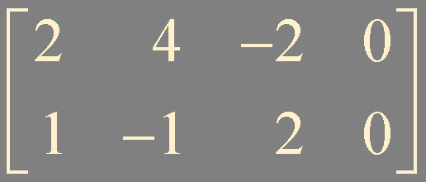
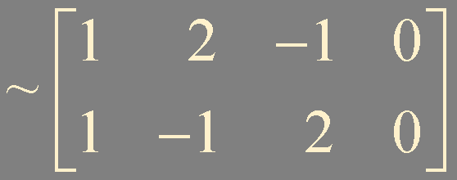
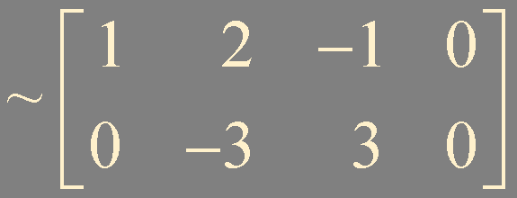
Example 3.
linearly dependent

Slide 15
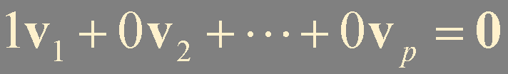
Theorem 9.
If a set contains the zero vector,
then the set is linearly dependent

Slide 16




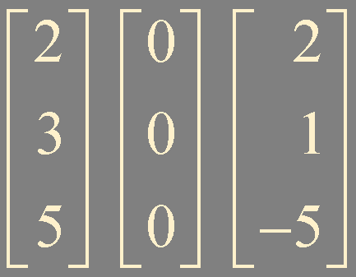
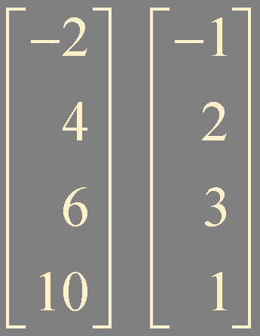
Example 4.
linearly dependent
linearly dependent
linearly independent

Slide 17
Summary
linearly dependent / independent
linear dependency of matrix columns
sets of one vector / two vectors
Theorem 7-9

